Slide 1
Algorithms
Lecture #07
Dr.Sohail Aslam

Slide 2
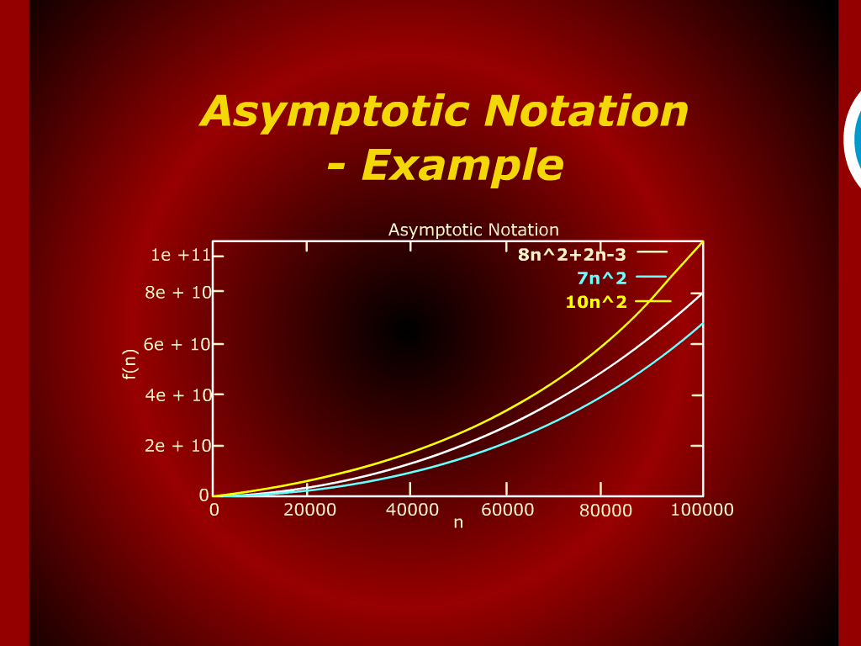
Asymptotic Notation - Example

Slide 3
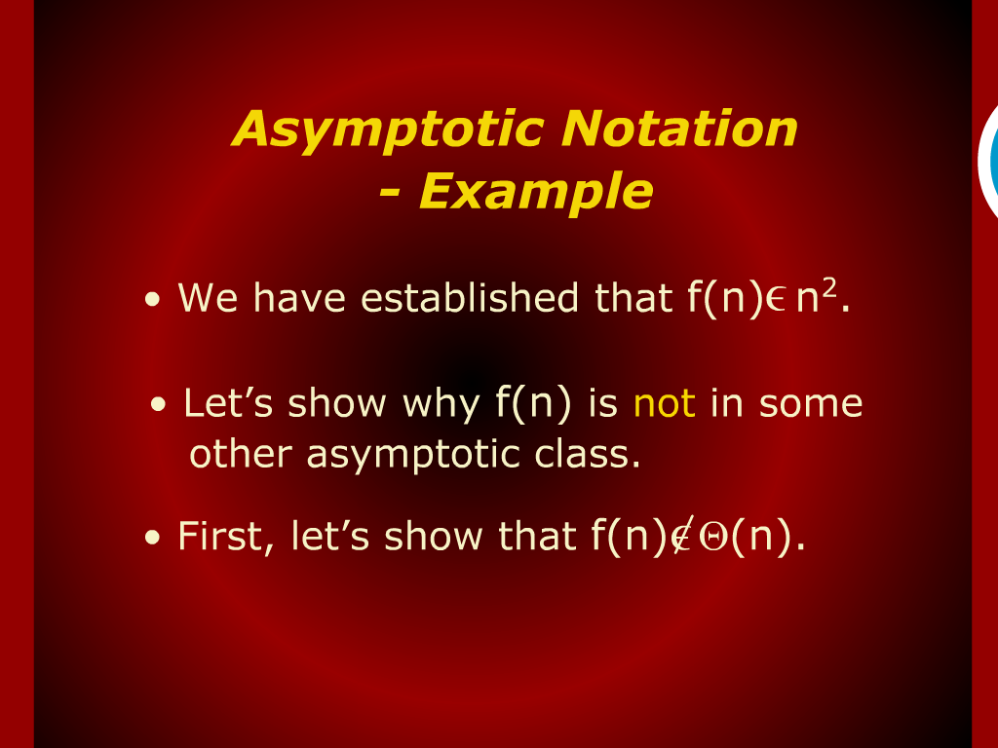
Asymptotic Notation - Example

Slide 4
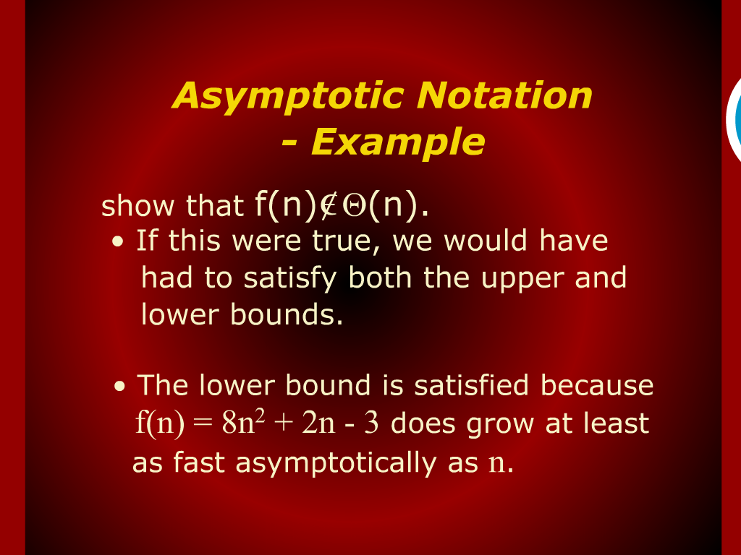
Asymptotic Notation - Example

Slide 5
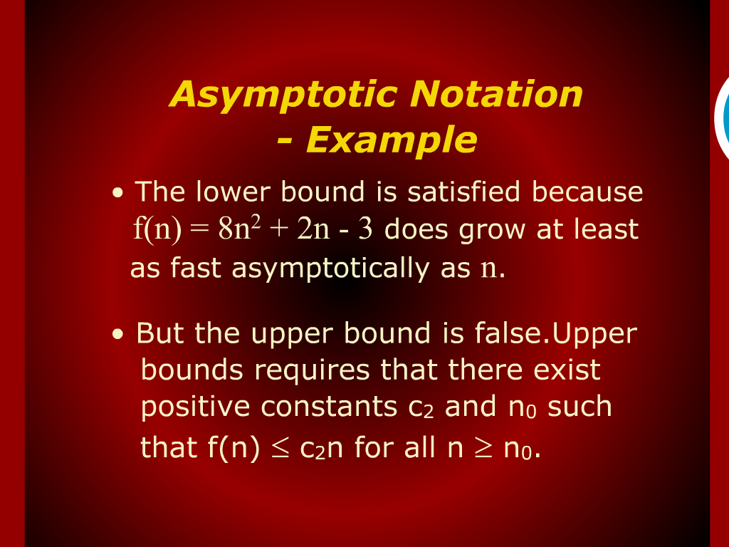
Asymptotic Notation - Example

Slide 6
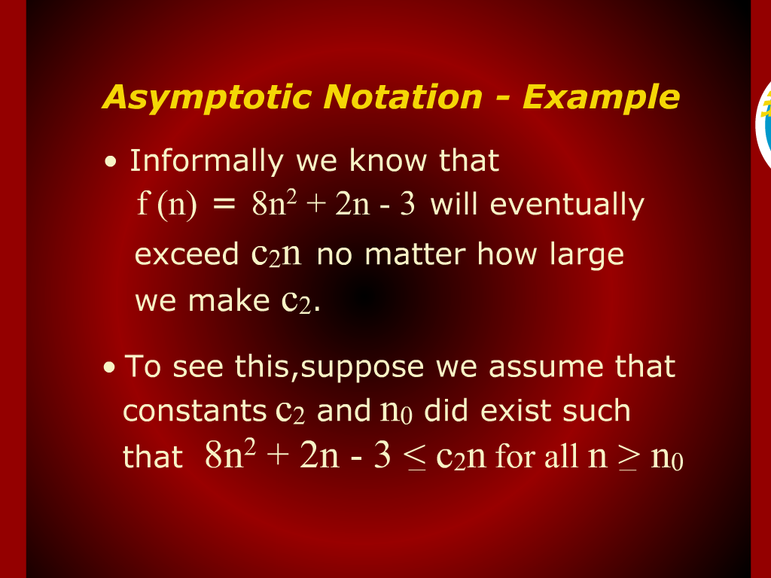
Asymptotic Notation - Example

Slide 7
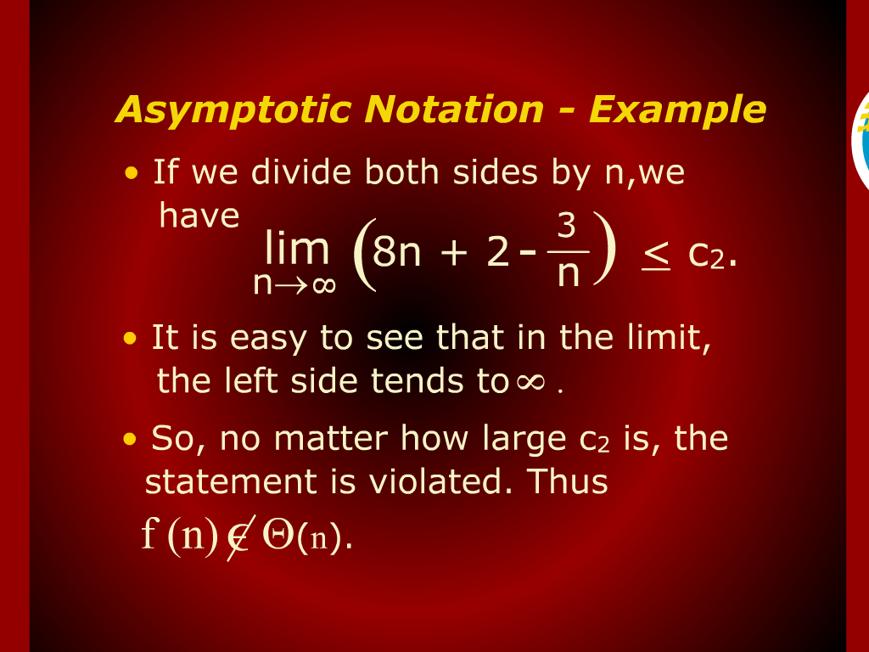
Asymptotic Notation - Example

Slide 8
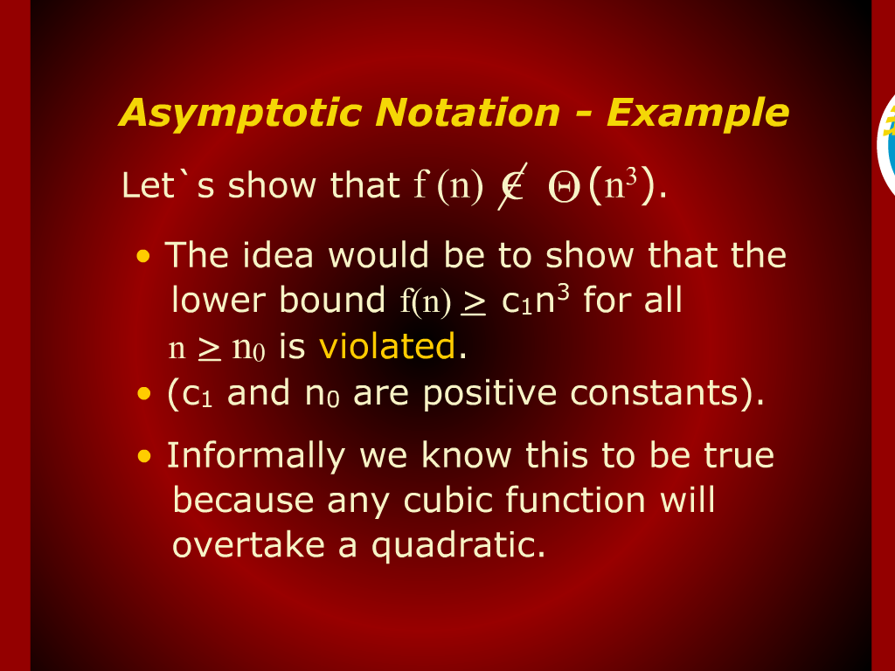
Asymptotic Notation - Example

Slide 9
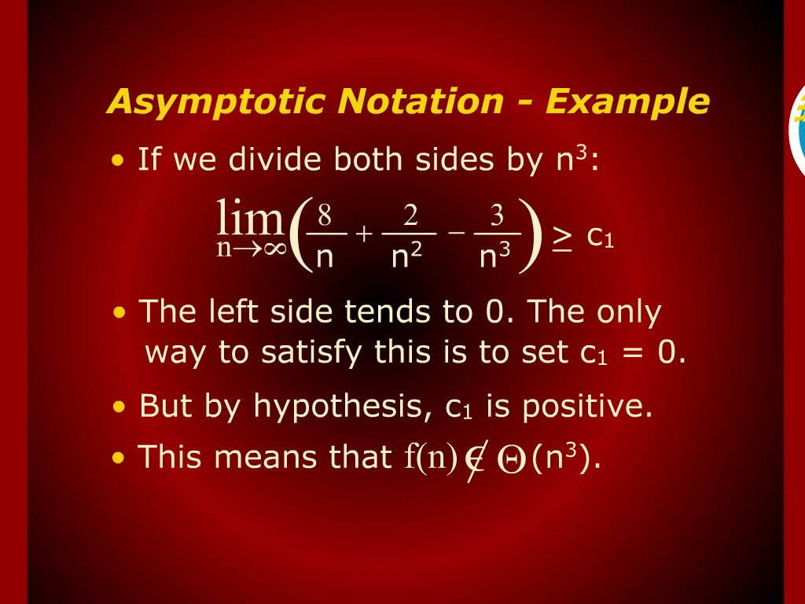
Asymptotic Notation - Example

Slide 10
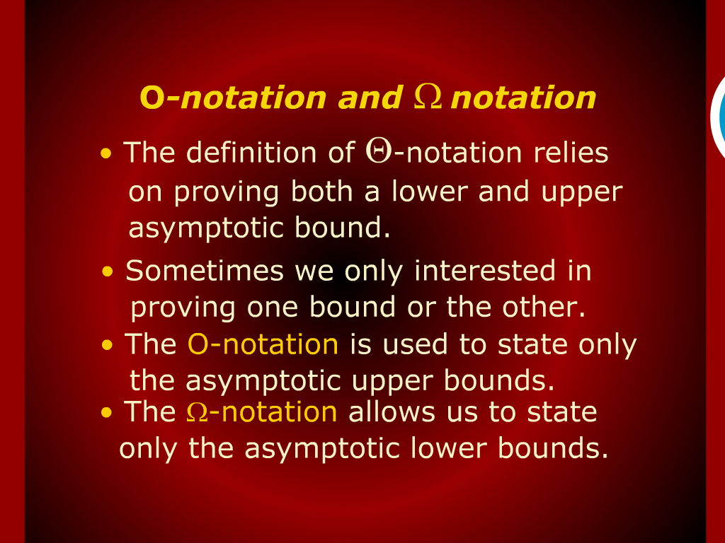
O-Notation…

Slide 11
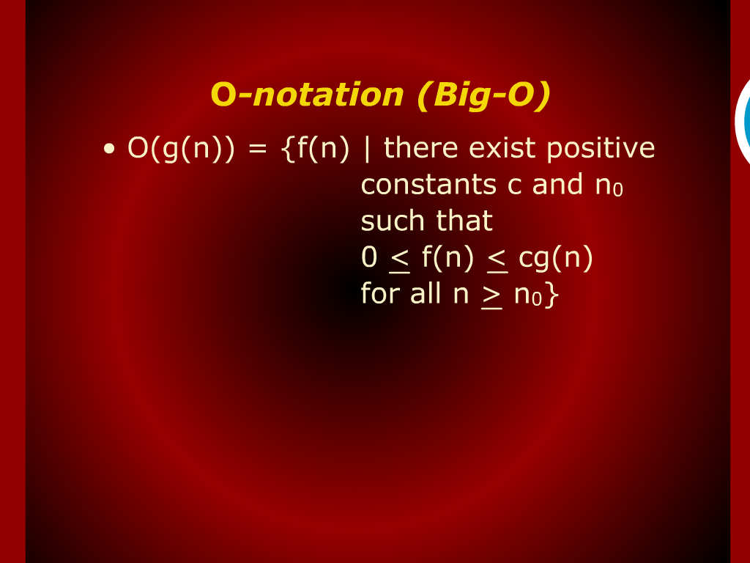
O-Notation (Big O)

Slide 12
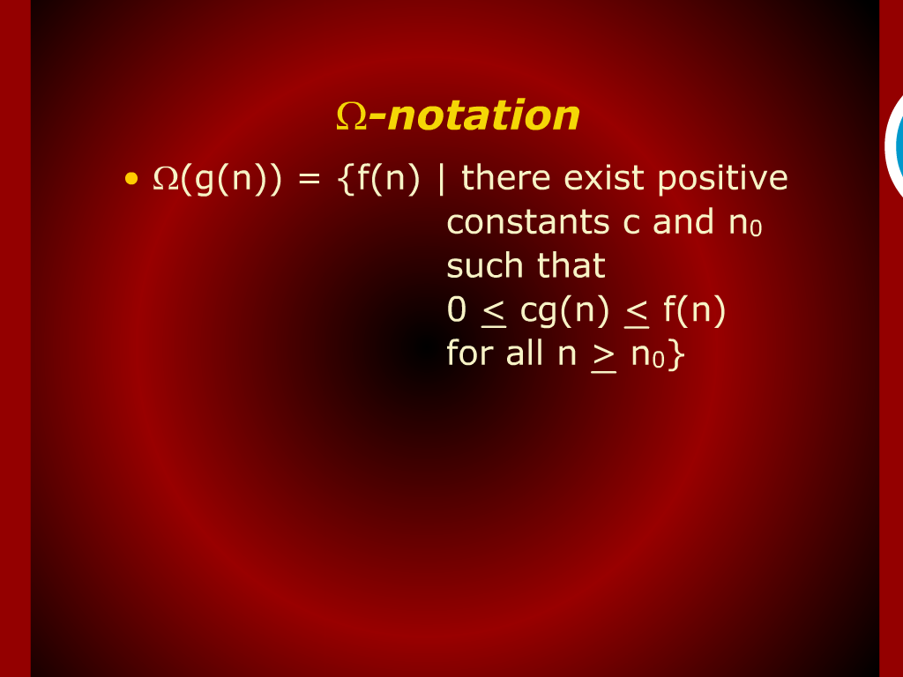
Notation

Slide 13
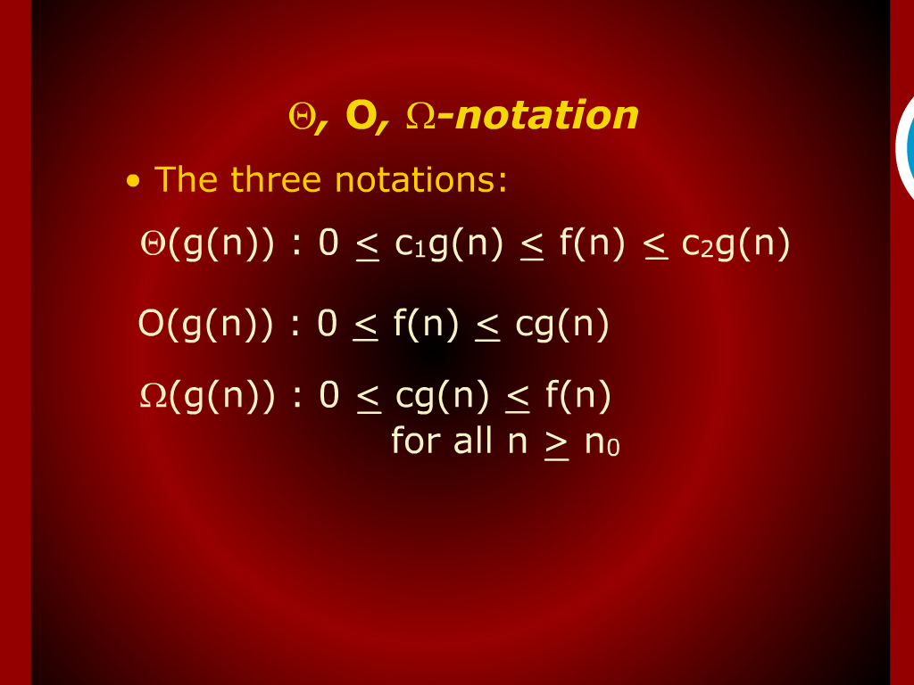
Notation

Slide 14
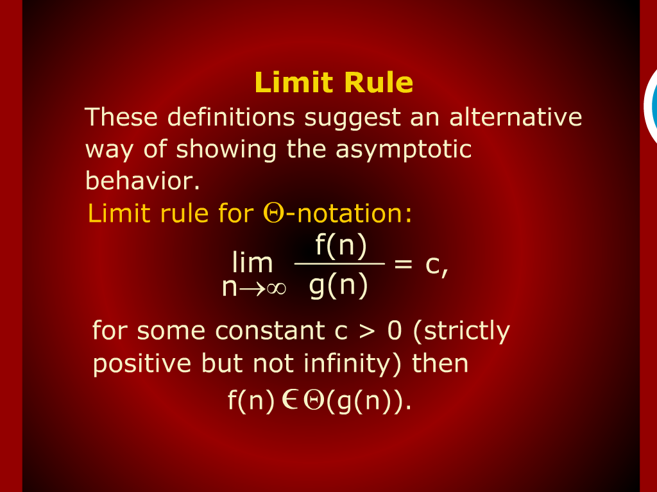
Limit Rule

Slide 15
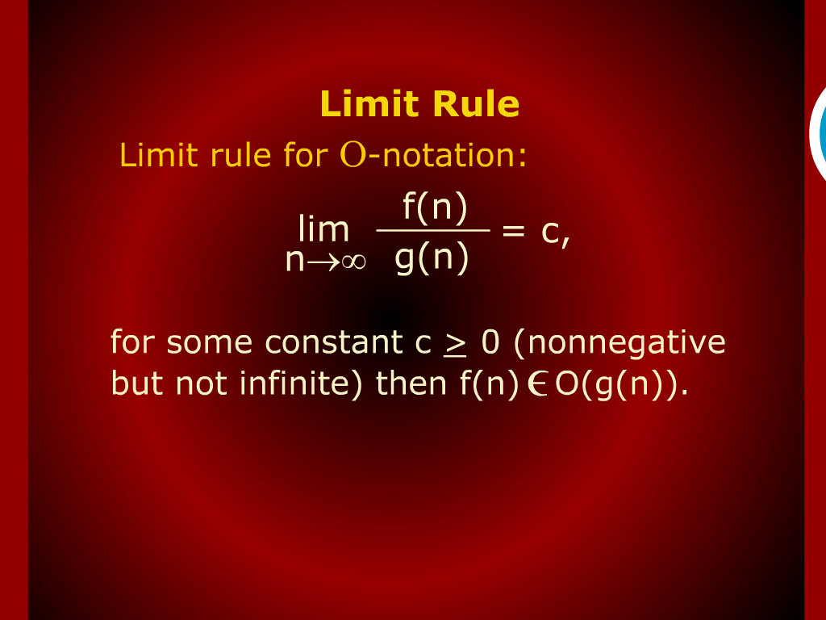
Limit Rule

Slide 16
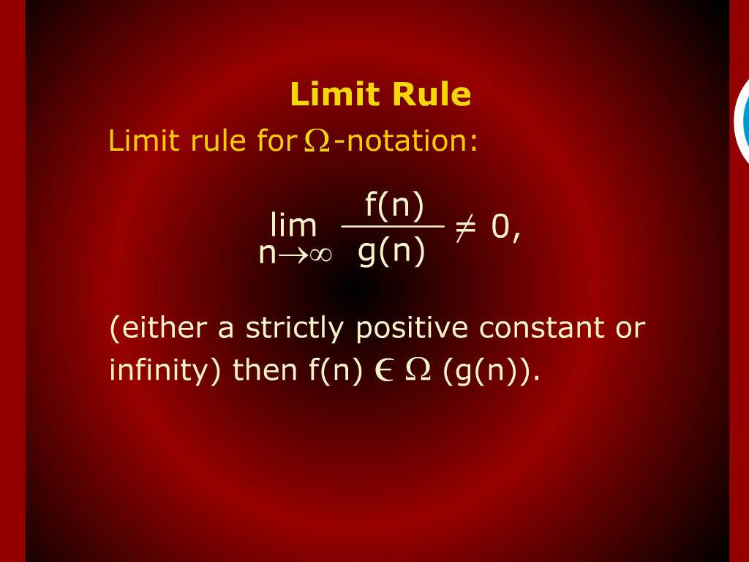
Limit Rule

Slide 17
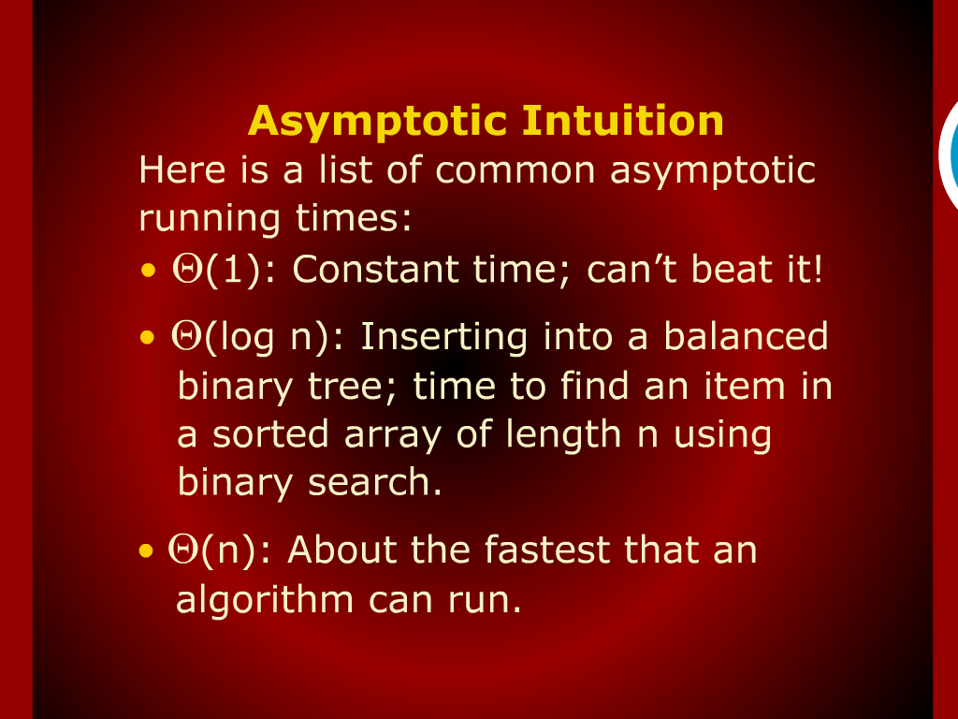
Asymptotic Intuition

Slide 18
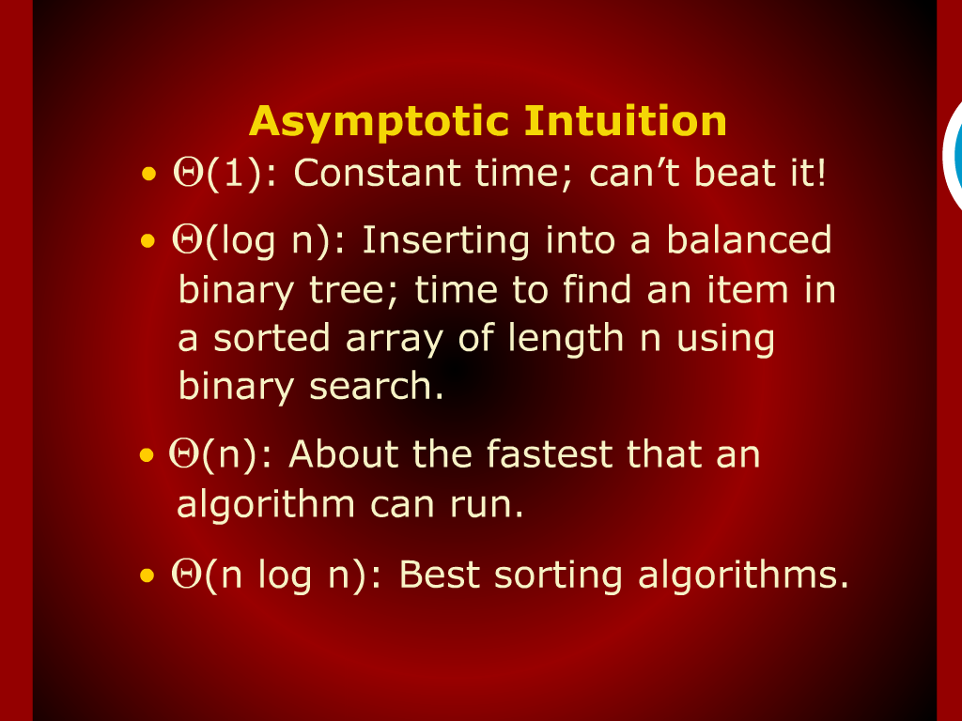
Asymptotic Intuition

Slide 19
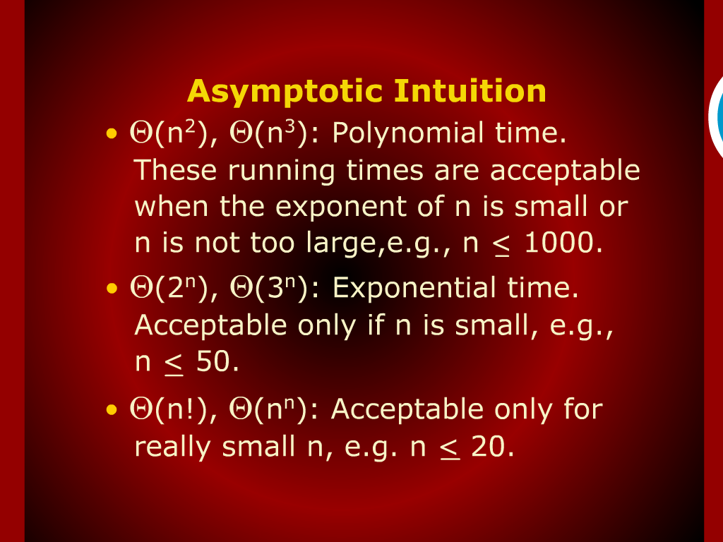
Asymptotic Intuition

Slide 20
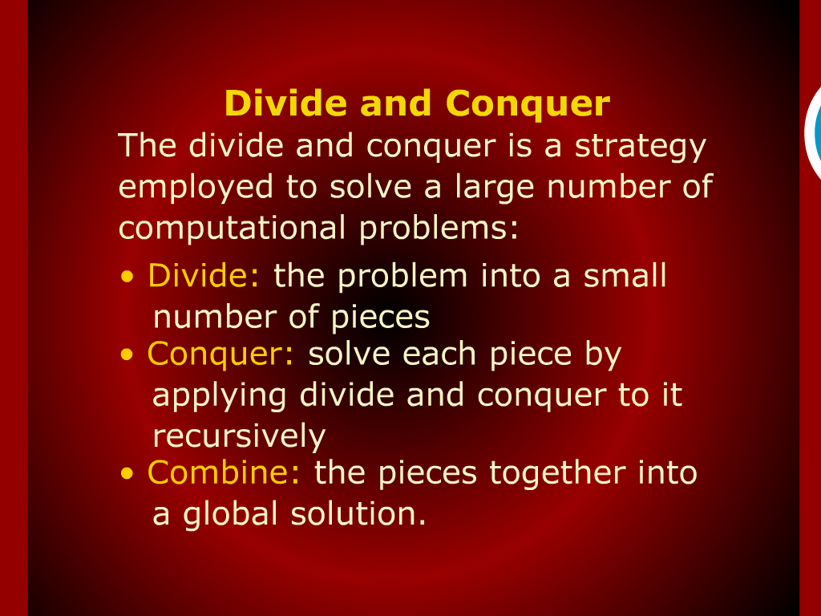
Divide and Conquer

Slide 21
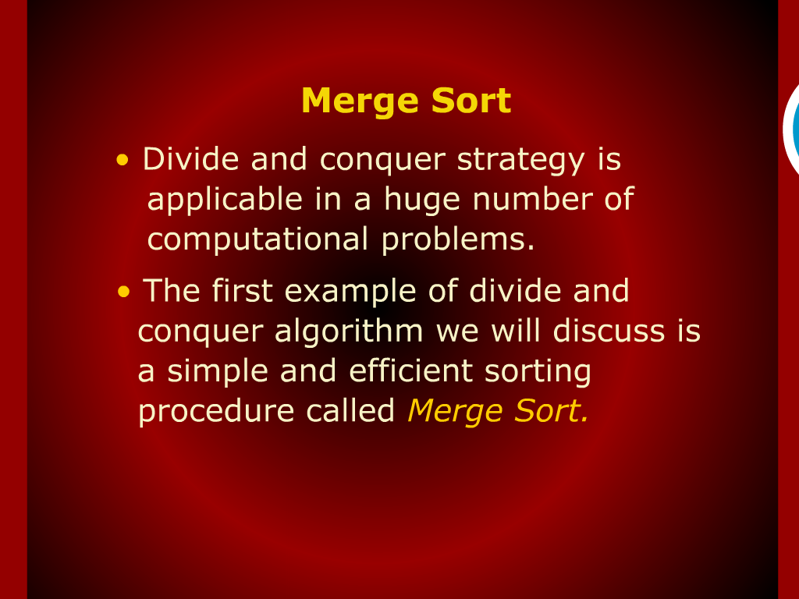
Merge Sort

Slide 22
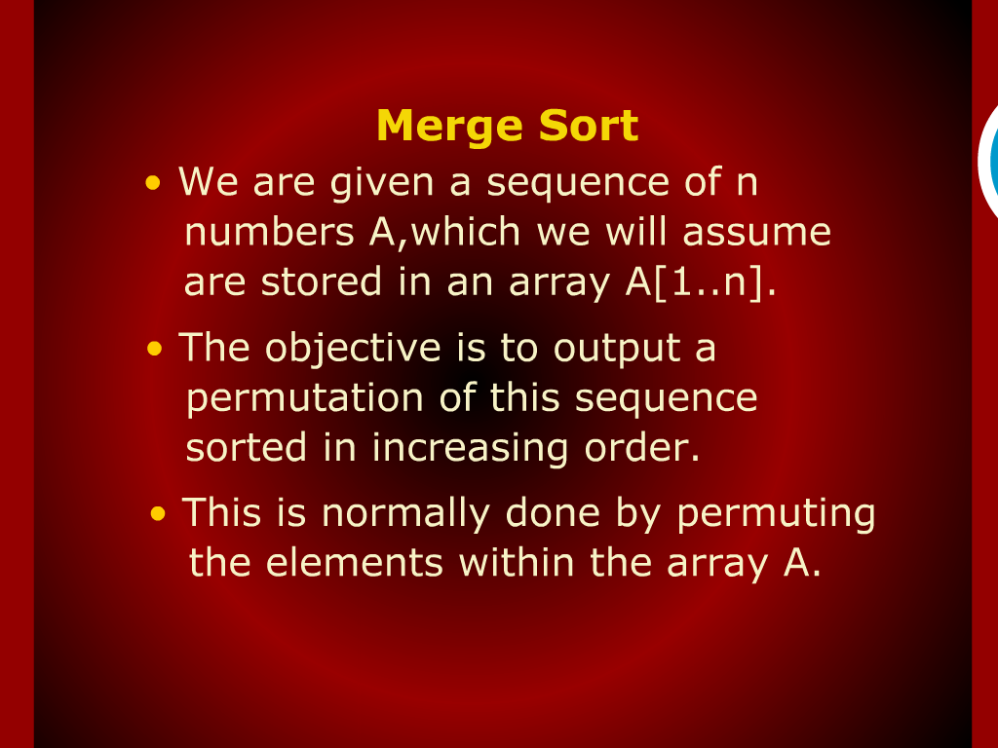
Merge Sort

Slide 23
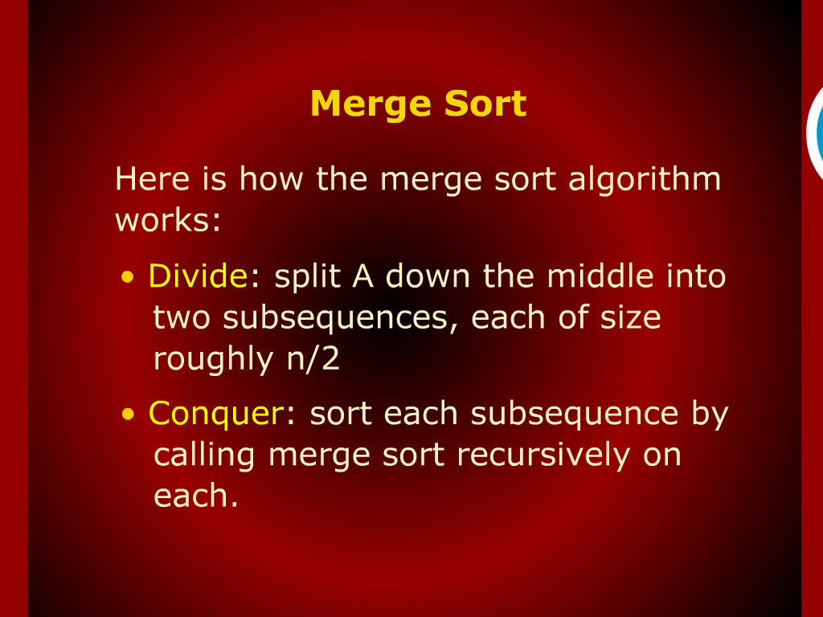
Merge Sort

Slide 24
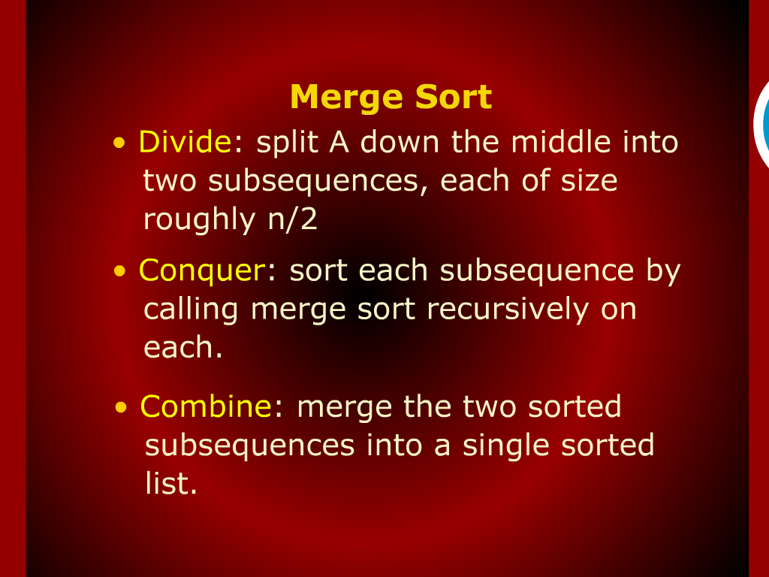
Merge Sort

Slide 25
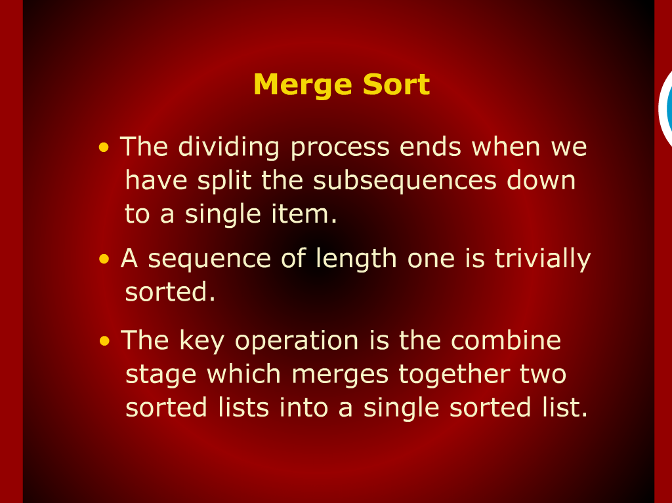
Merge Sort

Slide 26
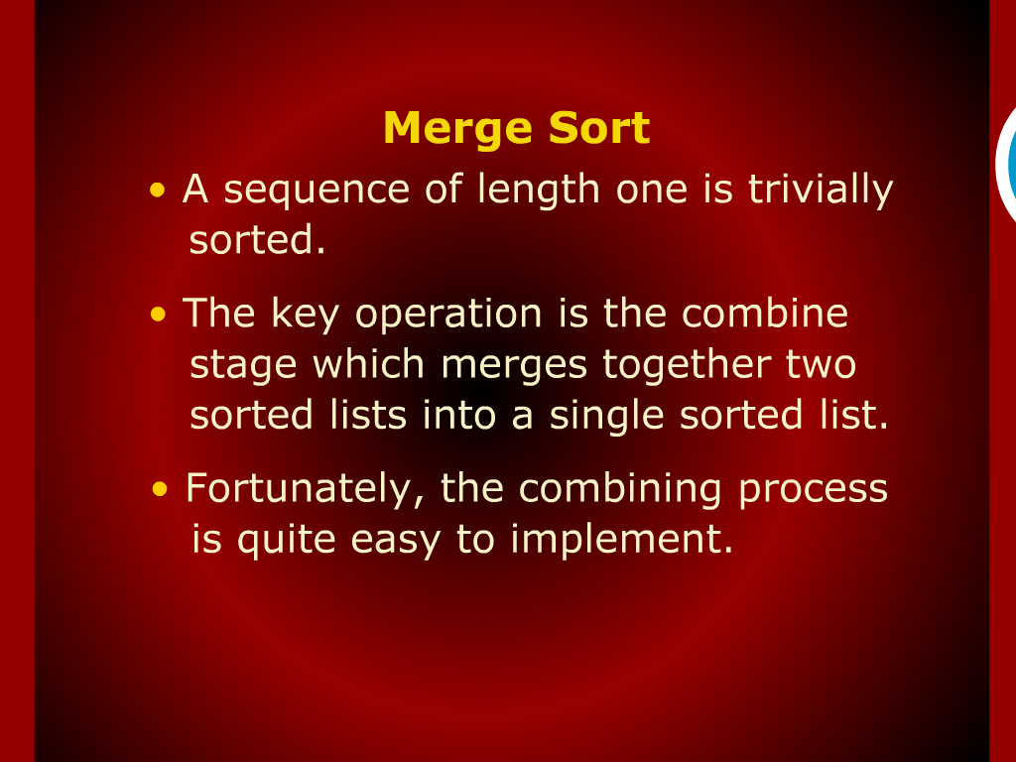
Merge Sort

Slide 27

Divide and Conquer Strategy

Slide 28
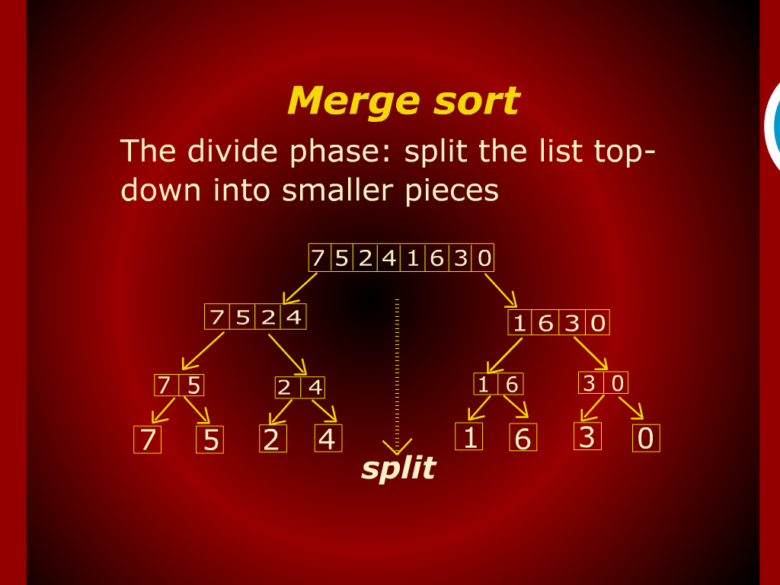
Merge Sort

Slide 29
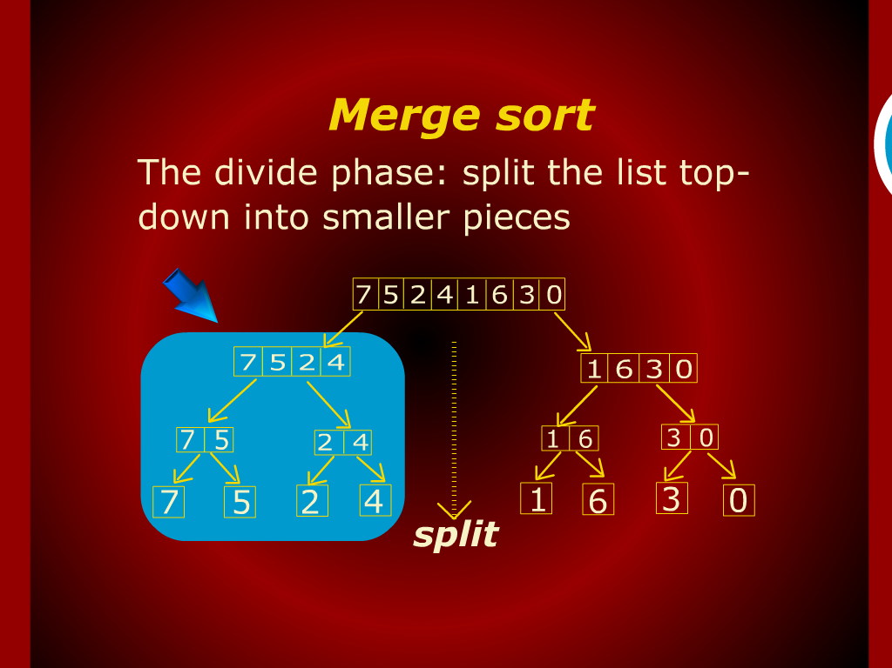
Merge Sort

Slide 30
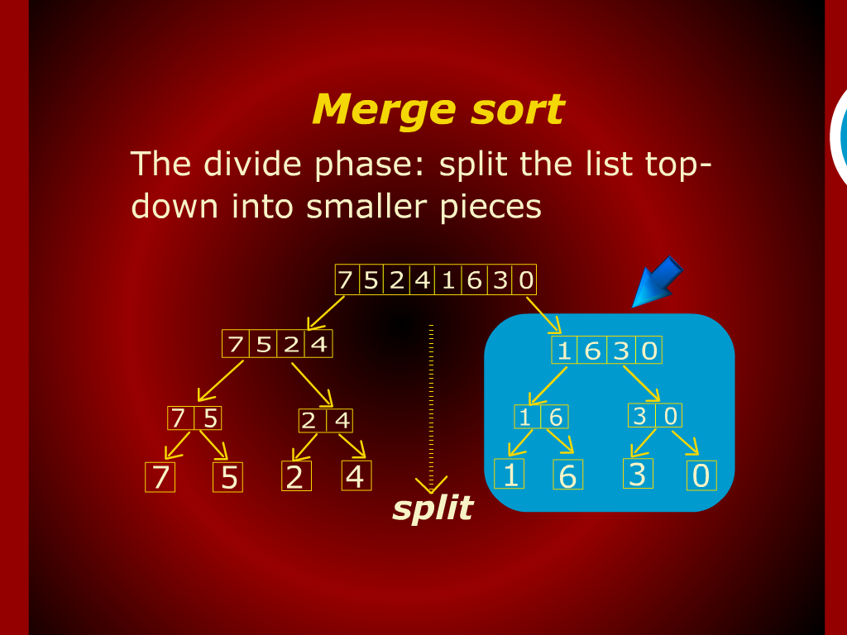
Merge Sort

Slide 31
Limit Rule

Slide 32
Merge Sort

Slide 33
Design
and
Analysis of Algorithm

Slide 34
